Slide 1
ARS Science Network (SciNet)
Status Update and Roadmap
USDA LTAR Annual Workshop, Feb 25, 2016
Archbold-Station, FL

Slide 2

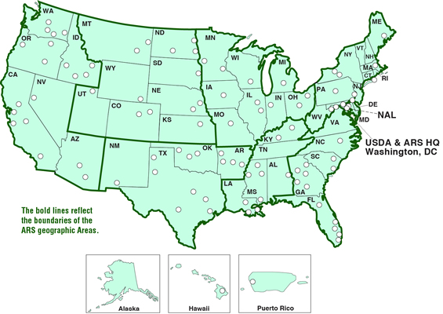
Background: Performed Assessment
Scientific Computing and Infrastructure, 2013-2014
Representative of ARS sites nationally
Significant IT users
Computing or data storage
Generate or handle large or complex datasets

Slide 3
Background: Interviews
Talked to Scientists, Leadership, and IT across the Agency
192 people interviewed from 22 locations
7 sites visited, including 4 with complete infrastructure assessments

Slide 4
Background: Assessment Map
Old map
Infrastructure
Site Visits
Represented

Slide 5
Background: Overall Findings
Key Takeaways
University proximity: good for researchers
Lack of proximity: more difficult, isolated
Largest IT gaps: infrastructure & informatics
DNA sequencing analysis major driver
Mixed IT review: some locations good, others quite bad
Scattered high performance computing (HPC)
Network bandwidth still generally inadequate
High-capacity storage needed, data is at risk!
Specialized IT support is needed!

Slide 6
What is SciNet?
High-performance research computing environment for ARS
SciNet Network Services: high-speed research network, with Internet2 connection
Computing Resources
Local HPC Cluster - Done
Cloud-based compute - In progress
Application Layer in between - In progress
Storage: Local high-speed (Done) and Cloud storage - In progress
Virtual Research Support Core (ramping up)
Primary Deployment is Complete! Being tested by users

Slide 7
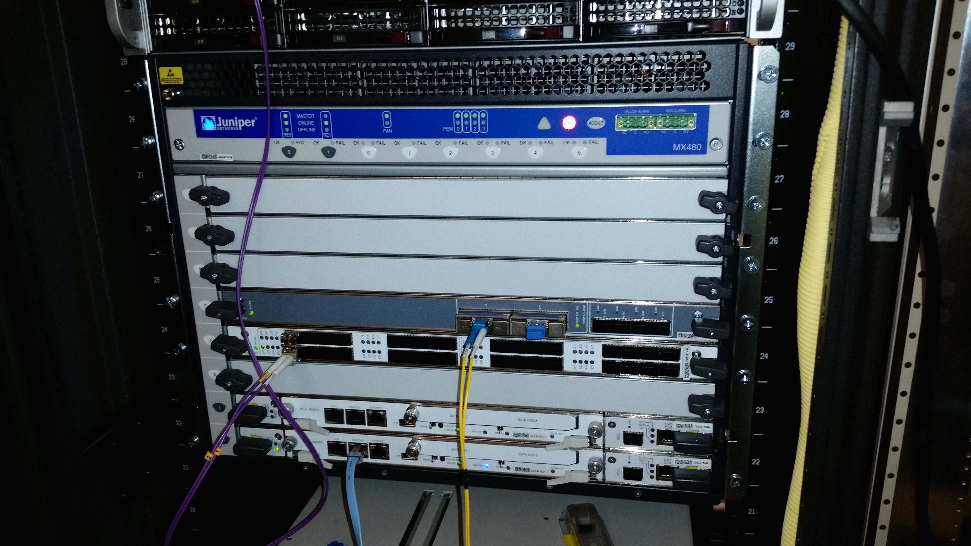
SciNet Network Services
11

Slide 8
SciNet Network Services
National network map for SciNet, Core is complete (black lines), Red lines being developed now
Notes:
Beltsville External Access
Point is Priority

Slide 9
SciNet Network Services
Deployment is complete, next is to integrate scientists and equipment at locations
Ames, IA (100Gb)
Beltsville, MD (100Gb, external gateway)
Albany, CA (100Gb, external gateway)
Fort Collins, CO (10Gb)
Clay Center, NE (10Gb)
Stoneville, MS (10Gb)

Slide 10
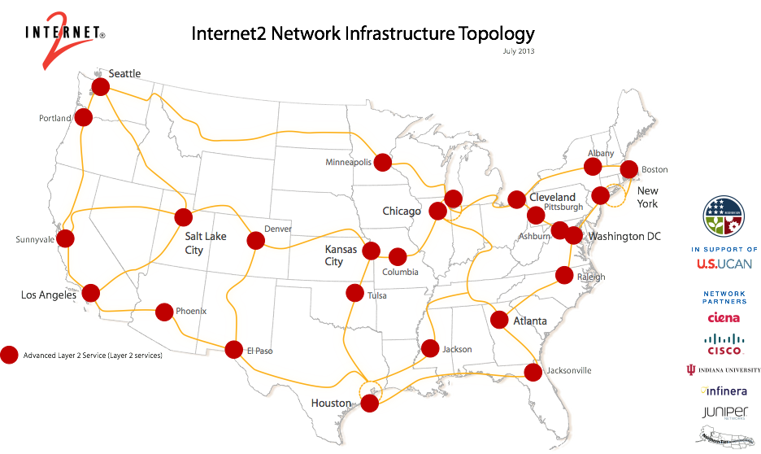
Internet2: Not the internet!
Network service provider, national high-speed network for research, education, and commercial members

Slide 11
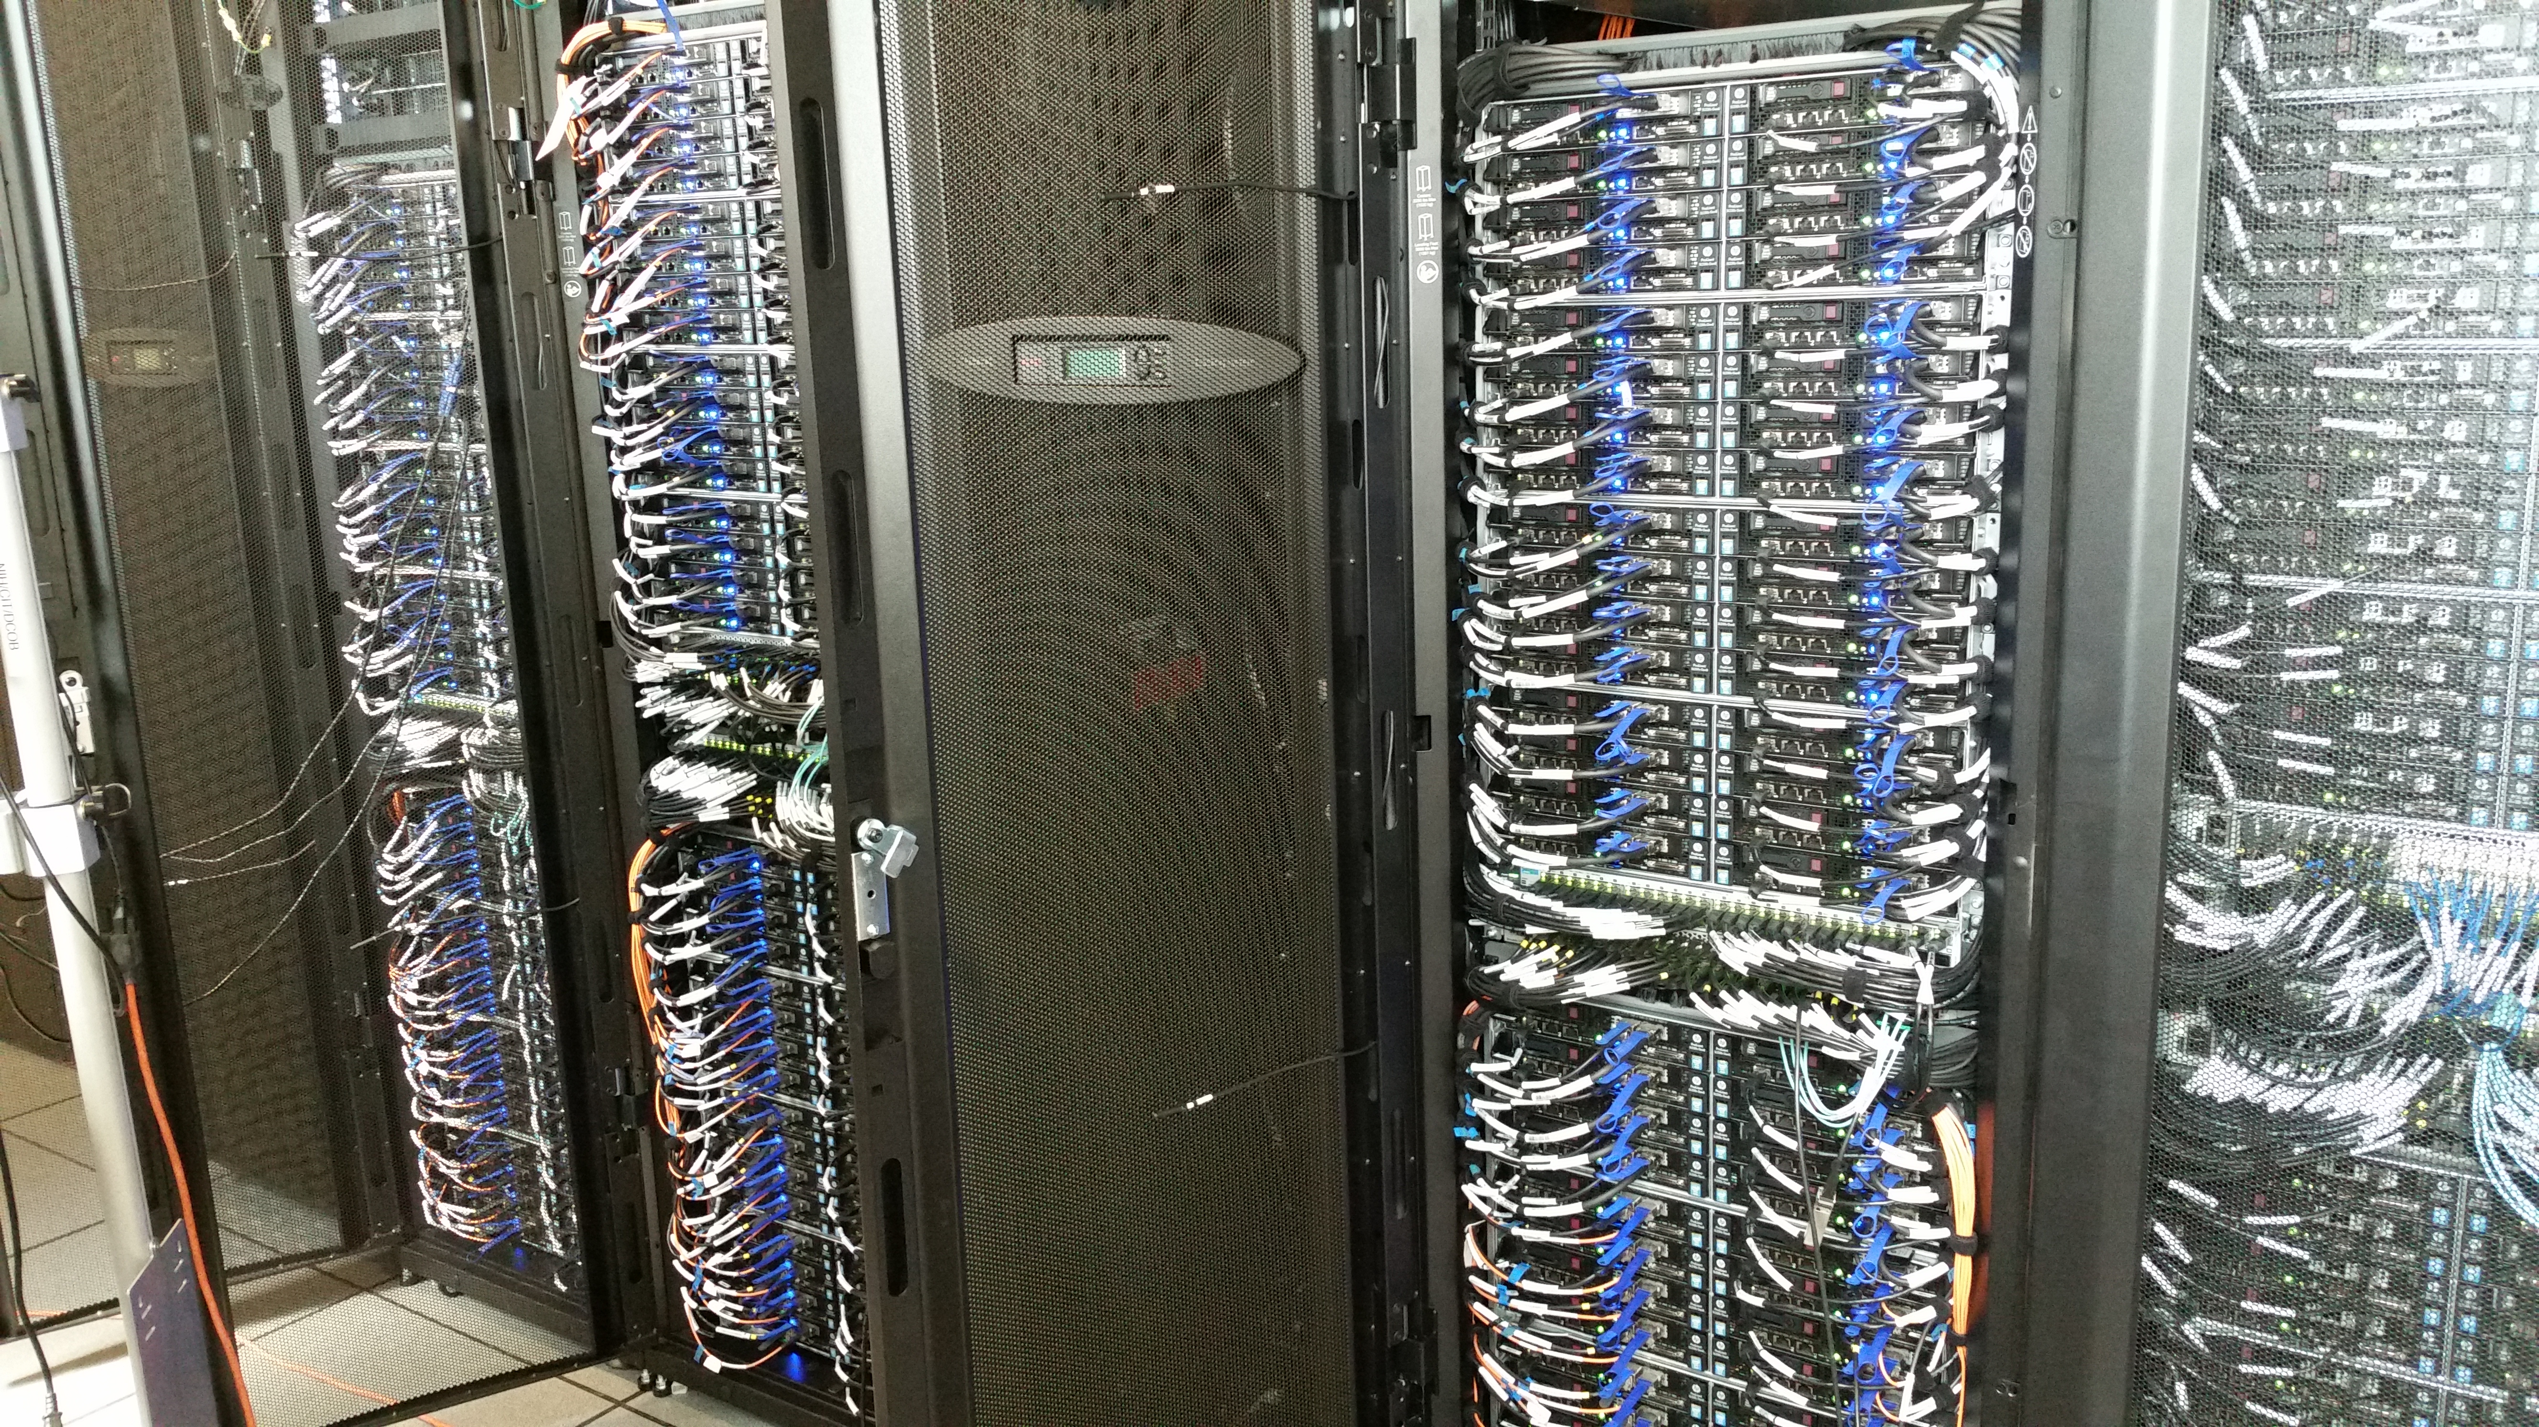
Compute and Storage
Up to a two line subtitle, generally used to describe the takeaway for the slide

Slide 12
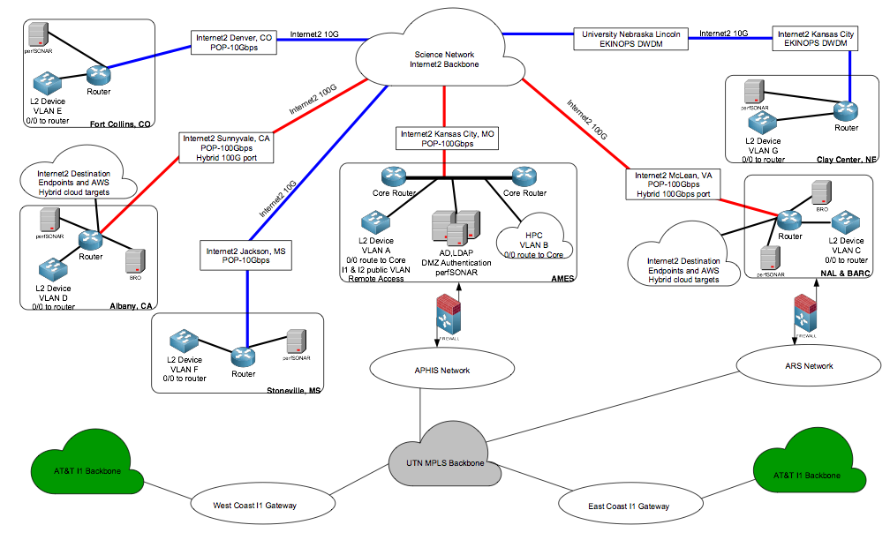
High-Level SciNet Topology

Slide 13
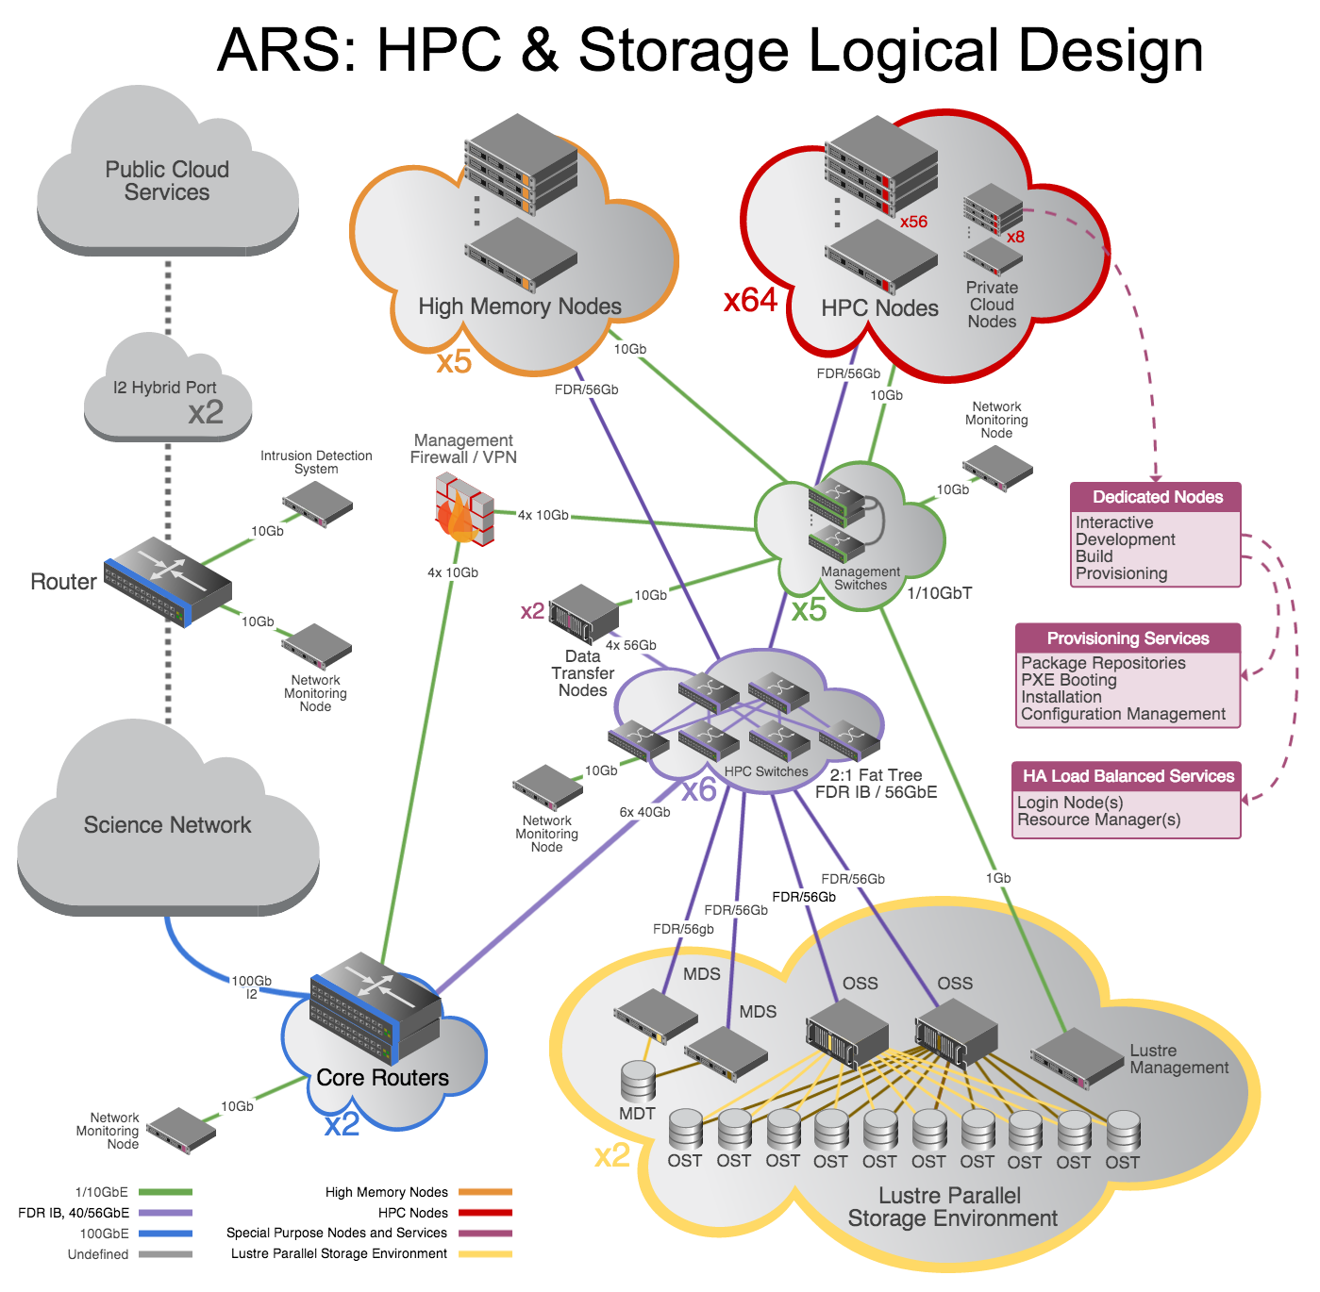
Computational Resources
Provisionally named Ceres, Scientific Computing Resources
Local Supercomputer (HPC; 1500 processors; Complete)
Local Storage (1.3PB; Complete)
Cloud Storage (Backup/Archive)
Cloud Compute (Bursting, Development, testing)

Slide 14
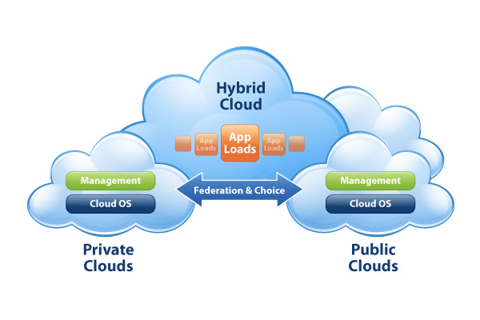
ARS SciNet: Hybrid HPC
A hybrid high performance computing system, private and public cloud functions
Extends Local HPC
Cloud functionality is major focus for next six months
Function as a single "private cloud" for ARS scientists
Scalable, cost-effective compute resources in the Cloud when local resource full
Cloud provides backup, disaster recovery, and high-availability functions to SciNet

Slide 15




Typical Workflow
Desktop as a gateway to everything
Virtual Core Coverage
SciNet
Workstation
Instruments
Instruments
Compute
Compute
Compute
Compute
Analysis
Analysis
Compute
Desktop
Compute
Compute
Compute
Compute
Compute
Cloud Compute
Compute
Local Storage
Data
Desktop
VM
Software
Cloud Storage
Development
Cloud Storage
VM
Data
Instruments
VM
Cloud Storage
Firewall
Cloud Storage
Cloud Storage
Cloud Storage
Data Ingest
ARSNet
Web Service
SciNet
Collaborators
Data Repositories
Remote Instruments

Slide 16
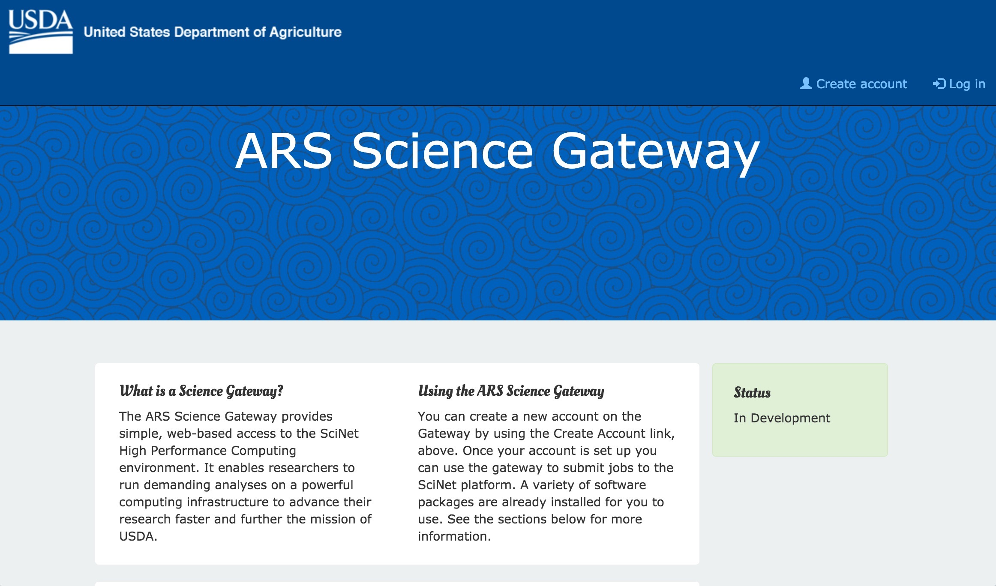
ARS Science Gateway

Slide 17

Virtual Research Support Core

Slide 18
Virtual Research Support Core
Proper support is the most important aspect of SciNet, Virtual Core is active now
Ramp up Virtual Core Activities Feb - Jun:
Project Management (20% of resources)
Research IT Support (50% of resources)
HPC, Cloud, Storage, and Network Engineers with experience in scientific support
System Administrators, Scientific Software Support (Linux experience)
Scientific Support (20% of resources, prioritize genomics and LTAR through June)
Data Management, Databases, and ETL
Bioinformatics and Sequence Data Analysis
Application Development
Modeling
Image processing
GIS (Geographic Information Systems)
Training (10% of resources)

Slide 19
Virtual Research Support Core
Our Staff
BioTeam
Ari Berman, Project Lead
Brian Osborne, Scientific Lead/User Testing
Aaron Gardner, HPC Lead
Bhanu Rekepalli, Science Gateway Lead/LTAR Lead/User Testing
Darrain Waters, Networking Lead
Adam Kraut, Cloud Lead/Modeling
Markus Dittrich, HPC/Software/Modeling
Anushka Brownley, User Testing/Software/Genomics
Simon Twigger, Software/Cloud/Science Gateway
Adam Marko, HPC/Software/Hardware
Digital Infuzion
Stephan Bour Virtual Core Co-lead (with Ari)

Slide 20
SciNet Accomplishments: FY2015
Digital Infuzion/BioTeam awarded implementation contract (January)
Establish SCInet at initial locations (March-November)
Install and configure HPC “Ceres” (April-November)
SCInet implementation team established (March )
Working Groups : SCInet Locations and HQ
Testing of the high performance cluster (October-November)
Scientific workshops leveraging Big Data infrastructure
RNAseq workshop, CSHL, NY ( Dec 2014) out of the I5K initiative
Database workshop PAG ( Jan. 2015), AgBio Database emerged from this activitiy, and includes data resources outside of USDA ARS
Population workshop CSHL, NY (April 2015)
Natural Resource/Animal Health Workshop Beltsville MD (July 2015)
Microbiome, workshop, Athens GA, SEA (August, 2015)

Slide 21
SciNet Applications
Working Group 2015, Testing Group Oct - Nov 2015
Identification of scientific applications & recruitment of beta testing
Identification of ~ 80 testers from 5 areas
More than 100 scientific applications were identified
Establishment of Alpha & Beta working groups
Leverage Agile approach with daily meetings
~ 20-30% of time dedicated to activity
Alpha testing of SciNet and HPC by limited number of ARS participants October – November
8 scientist at distributed locations
21 applications tested
Testing has resumed for first Beta Testing Group: 2/16/2016

Slide 22
SciNet Testing
The alpha testing was completed in December 2015
20 out of 21 applications “passed”
A number of applications ran much faster on Ceres than on the testers’ local resources
These were parallelized
Most of the alpha testers concluded that SciNet and Ceres were very valuable ARS resources that they would regularly use in the future
“I appreciated being able to test the Ceres HPC since it gave me the opportunity to run analyses on my largest dataset that were not possible locally"
Beta testing has begun

Slide 23
SciNet Testing
The alpha and beta testers, by subject matter:
Phylogenetics | 6
Genome Assembly | 10
Genome Annotation | 6
Population Genetics | 5
Sequence Comparison | 6
Metagenomics | 7
Hydrology and Soil Modeling | 12
Outbreak Modeling | 3
GIS | 2
RNA Analysis | 11
One tester can have >1 subject

Slide 24
SciNet Testing
The alpha and beta testers, by area:
Area | Testers
Northeast | 17
Midwest | 16
Pacific West | 10
Plains | 12
Southeast | 8
8 alpha and 56 beta (1 in both)

Slide 25
SciNet Testing
The alpha and beta testers, by program:
Program | Testers
CP & P | 25
AP & P | 18
NR & SAS | 11
NFS & Q | 5
NAL | 4

Slide 26
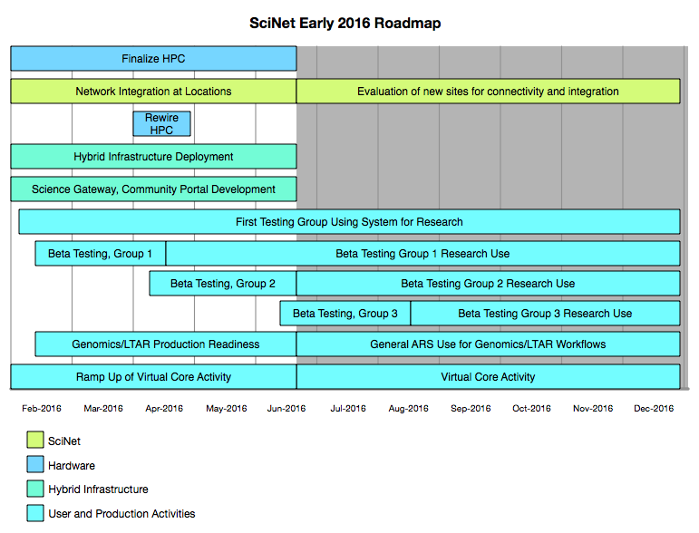
SciNet Deployment Timeline
Recently updated

Slide 27
Production Targets for June
Focusing on Major Areas of need first, will be developing the others simultaneously
LTAR
Common data ingest and analysis
Metadata consistency
Data Storage
Initial computational workflows
Genomics enabled science
Genome assembly: Genomes & Transcriptomes
Annotations: Structural & Functional annotations & Browsers
Genetic Variation: SNP/indel, GBS
Expression profiling : CLC & RNAseq tools
Community portals (ramping up, not production)

Slide 28

end; Thanks!

Slide 29
Overall SciNet Stats
1580 Processing Cores
15.5TB RAM
Four internal compute networks (management, provisioning, HPC, Infiniband)
480 Network Connections
1.32PB Lustre storage
Six locations: 10 - 100Gb connectivity
Internet2 backbone, using AL2S

Slide 30
HPC Technical Specifications
Compute Nodes
Total of 69 servers, all SuperMicro
64 conventional compute nodes
16 processor cores each
128GB RAM
10Gb Ethernet for management
40Gb Ethernet for HPC
56Gb Infiniband (FDR) for IPC and Storage
1TB local SSD for scratch
5 high-memory compute nodes
60 processor cores each
1.5TB RAM
Same networking and SSD

Slide 31
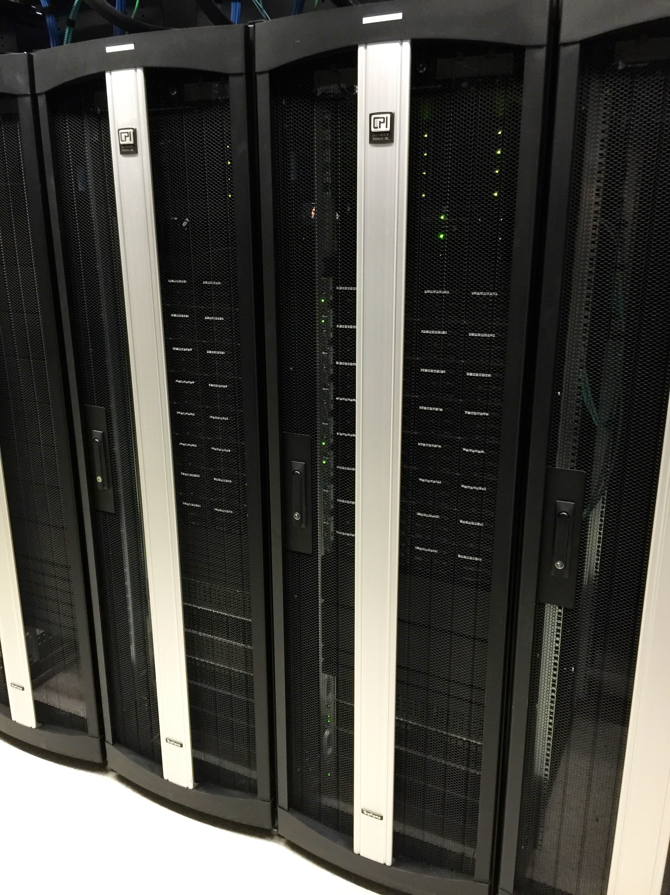
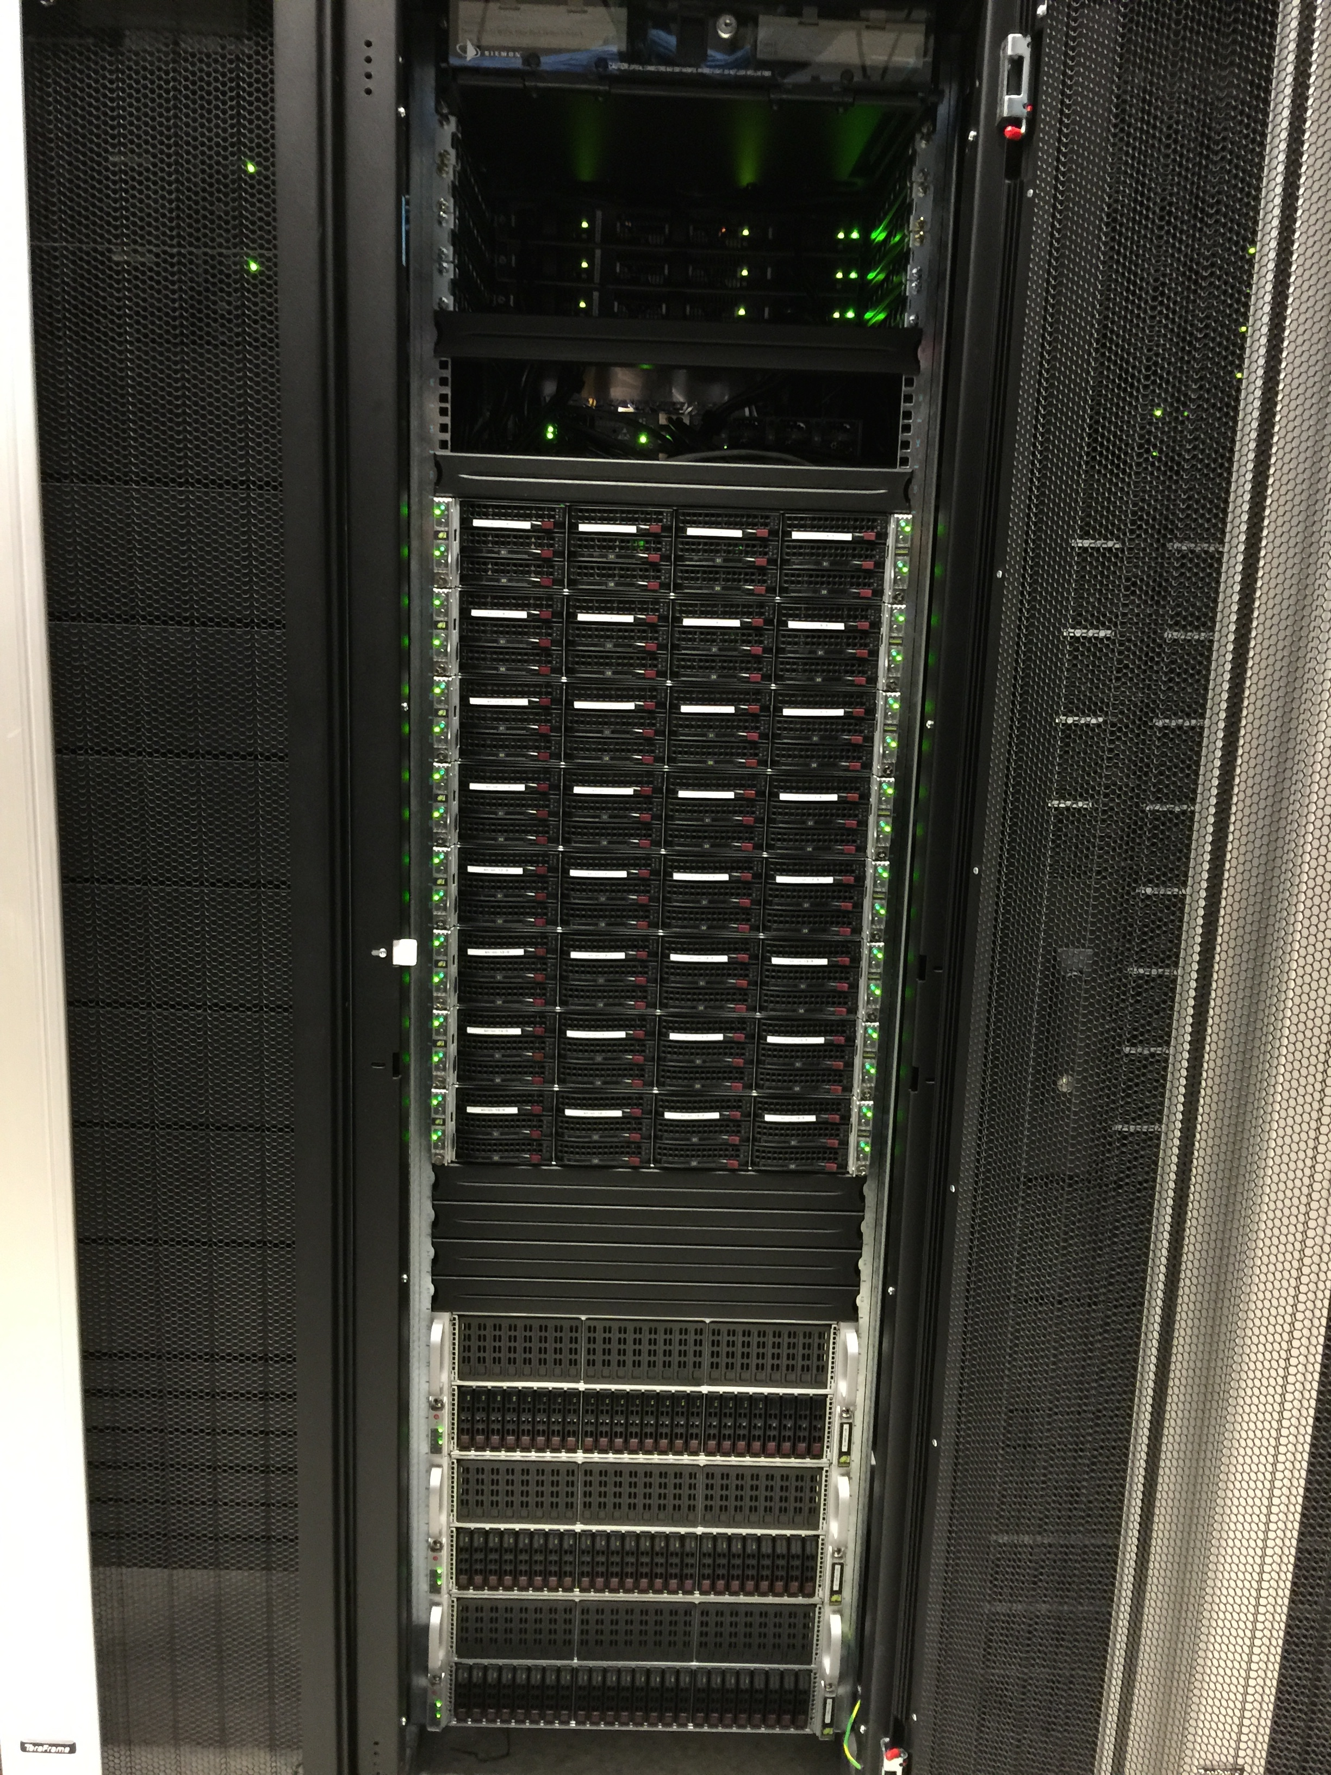
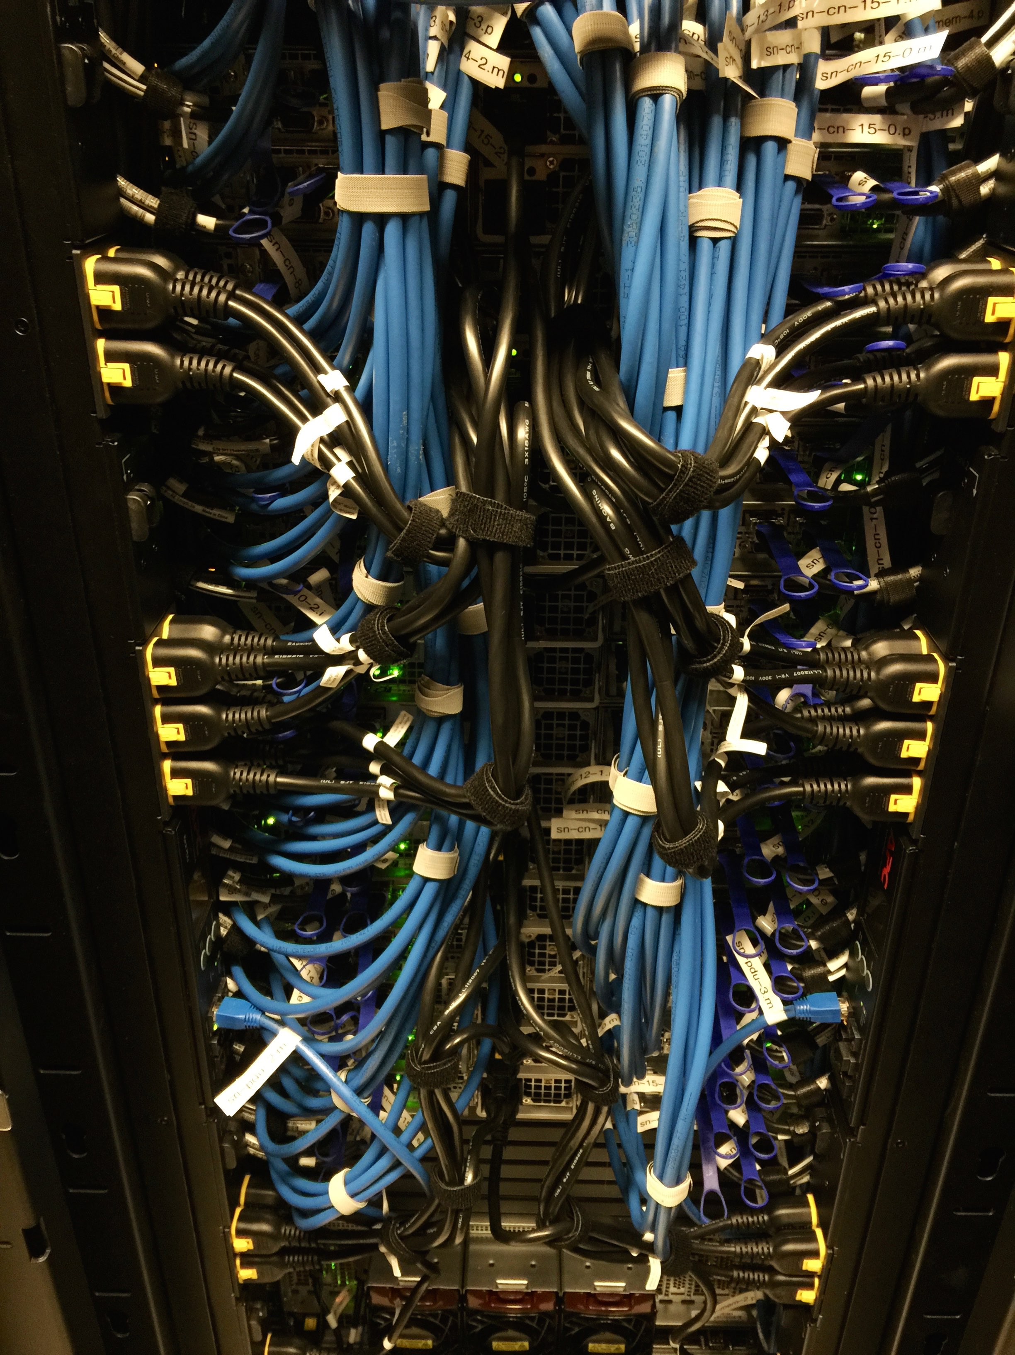
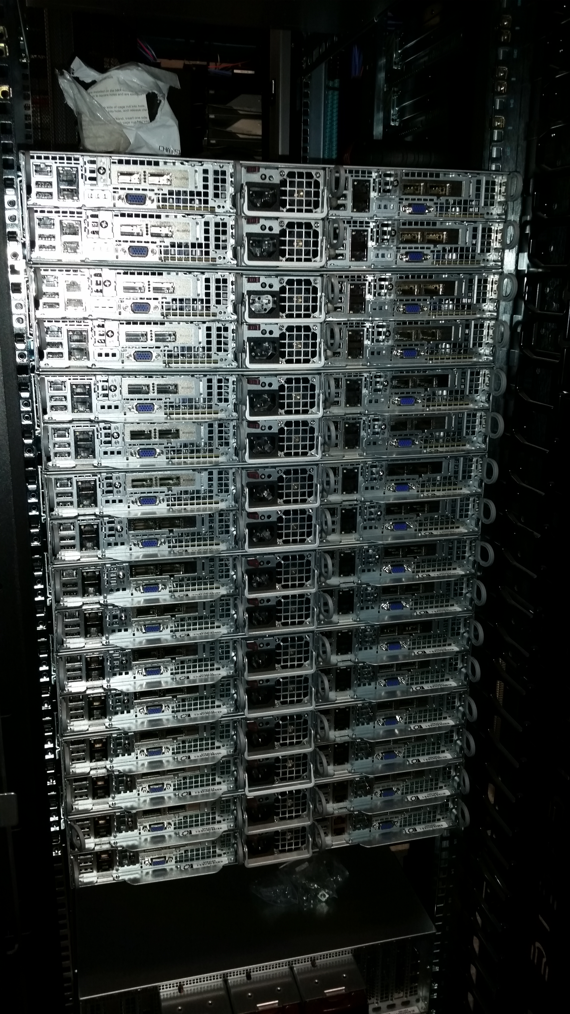
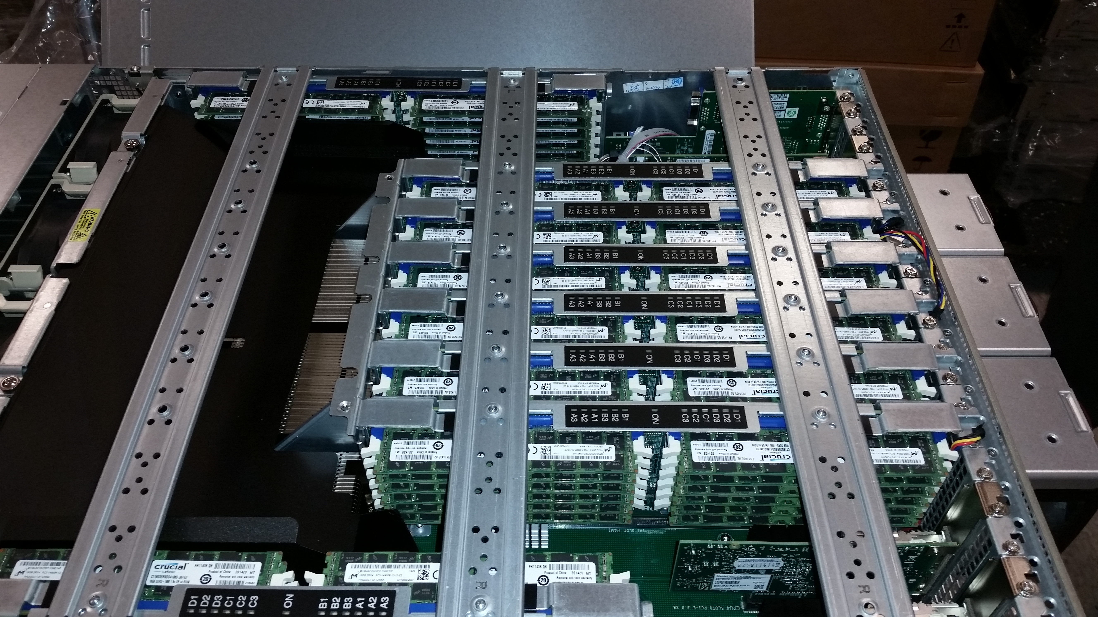
Compute: HPC

Slide 32
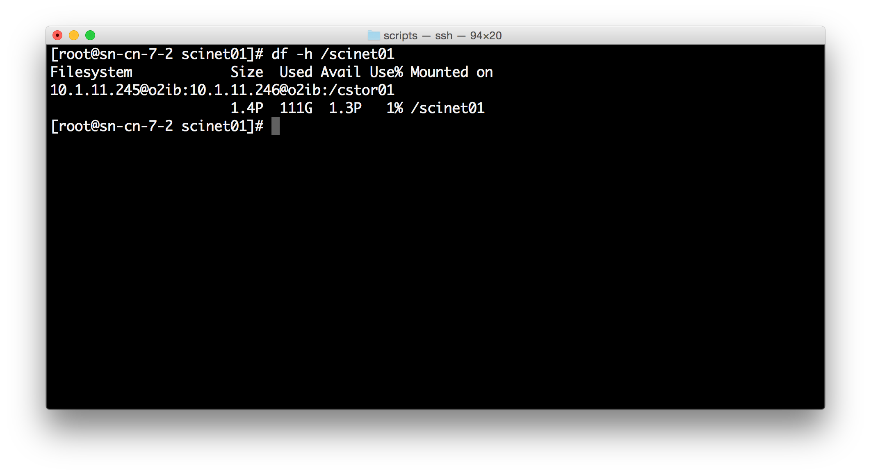
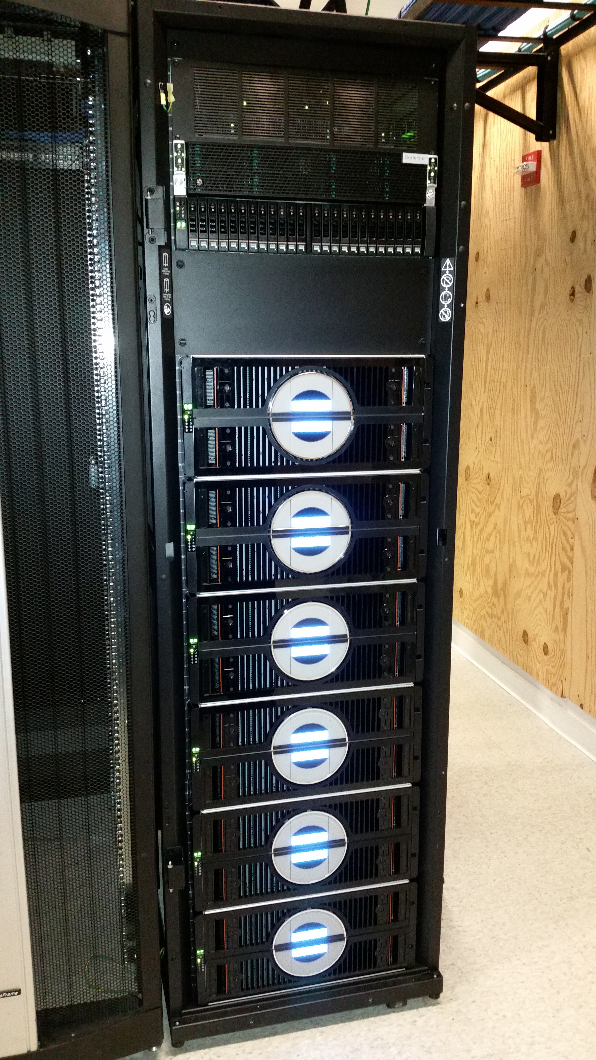
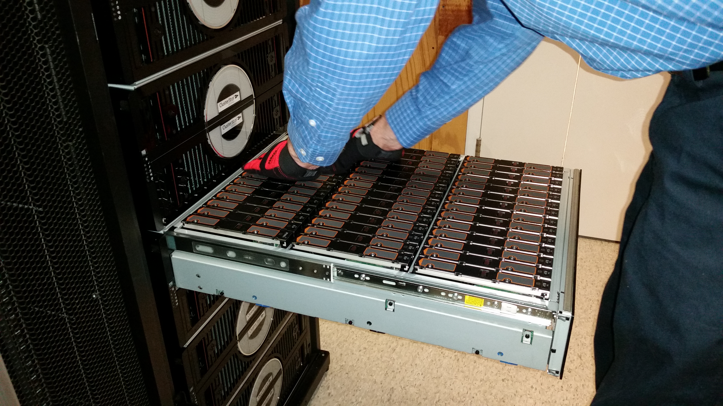
Storage
Lustre - Seagate ClusterStor 9000 - 1.32PB

Slide 33
System Specifications
Configuration
Main Operating System: CentOS Linux 6.6
Supported Virtual Machine Types:
CentOS Linux 6.6 & 7
Ubuntu Linux 12.04 LTS
Windows Server 2008
Services run from Linux containers (like Docker)
Compute nodes automatically provisioned
Cluster scheduler: SLURM
Metascheduler for bursting

Slide 34
System Specifications
Services
SciNet-based authentication: two-factor LDAP/Kerberos
Local DNS, NTP,
PXE Server for node provisioning
Ansible Server for configuration management
License Server
Database Servers: MySQL, PostgreSQL, Oracle?, MSSQL?
iRODS Server for policy and metadata management
Confluence (documentation, collaboration), Jira (ticketing), Stash (code repo)

